Slide 1

Data Science Project
Mewael Haile

Slide 2
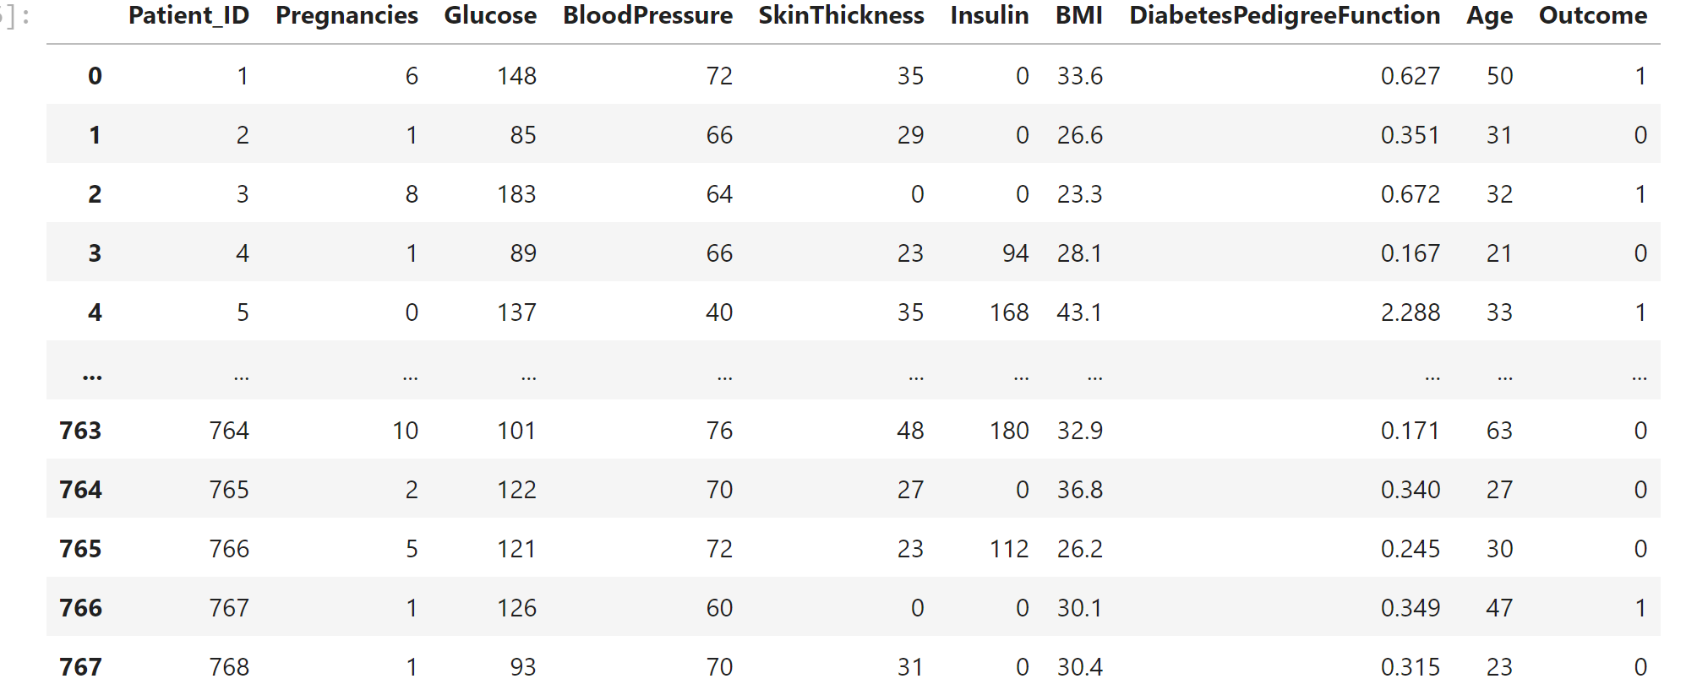
The Problem Statement
There has been an epidemic of people diagnosed with diabetes and the root cause is unknown. A pharmaceutical investor wants more research done on diabetes on what are the leading causes are to create medication. The board of directors appointed me as a data scientist to find the root cause of this problem.
Collected database with different sets of attributes that include glucose levels, blood pressure, insulin, BMI also the diagnoses on if they are diabetic or not
Tasked with finding out the main key indicators that cause diabetes

Slide 3
Benefits of the Analytics
The benefits of this study will lead to progress in helping reduce, prevent, and treat people who have diabetes
Help people who are pre diabetic to monitor the causes that lead to diabetes
This could aid in medication being created to treat diabetes

Slide 4
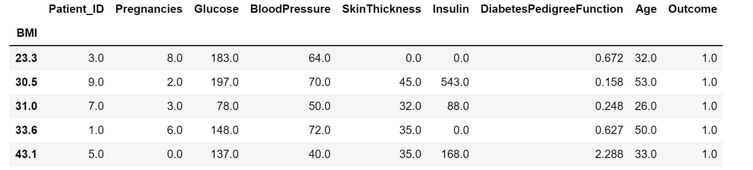
Methodology
I collected a database about patients with various attributes and I tried to create a connection between them
I found the average conditions of people who were diagnosed with diabetes and I grouped by BMI because according to the cdc being overweight (BMI of 25-29.9), or affected by obesity (BMI of 30-39.9) or morbid obesity (BMI of 40 or greater), greatly increases your risk of developing type 2 diabetes.

Slide 5
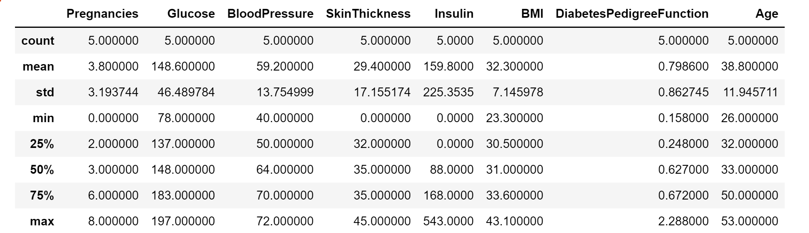
Patients with diabetic diagnosis levels
I then looked at the std to see which attributes could be a key indicator that may cause diabetes
Glucose and Insulin has the highest std and could be one of the leading causes with diabetes

Slide 6
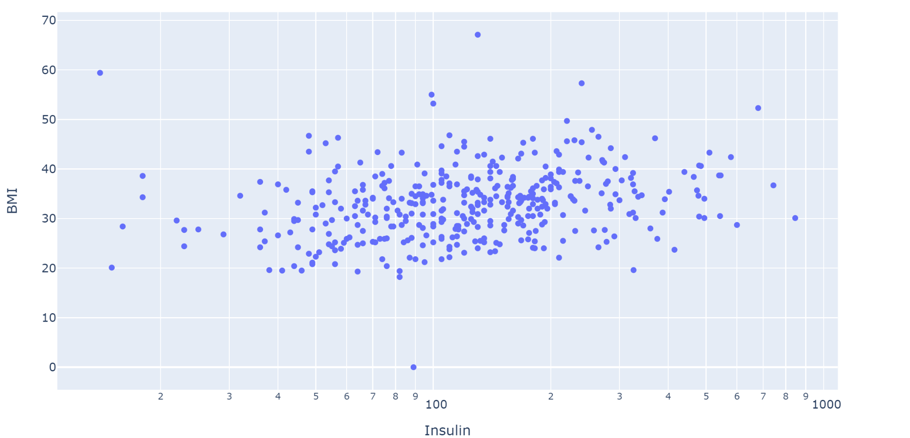
Scatter Visualization
This graph compares insulin and BMI I used this because of the high std
I wanted to see if insulin and BMI had a positive correlation
Even though the graph does not show a strong correlation it does show that it is positive

Slide 7
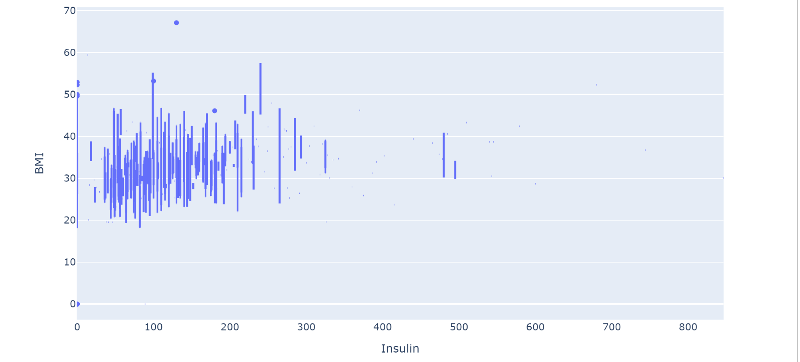
Box Plot Visualization
Box plot between insulin and BMI
Although insulin does show a positive correlation not much information can be gathered based on this data
I then used glucose and BMI to get a better visualization

Slide 8
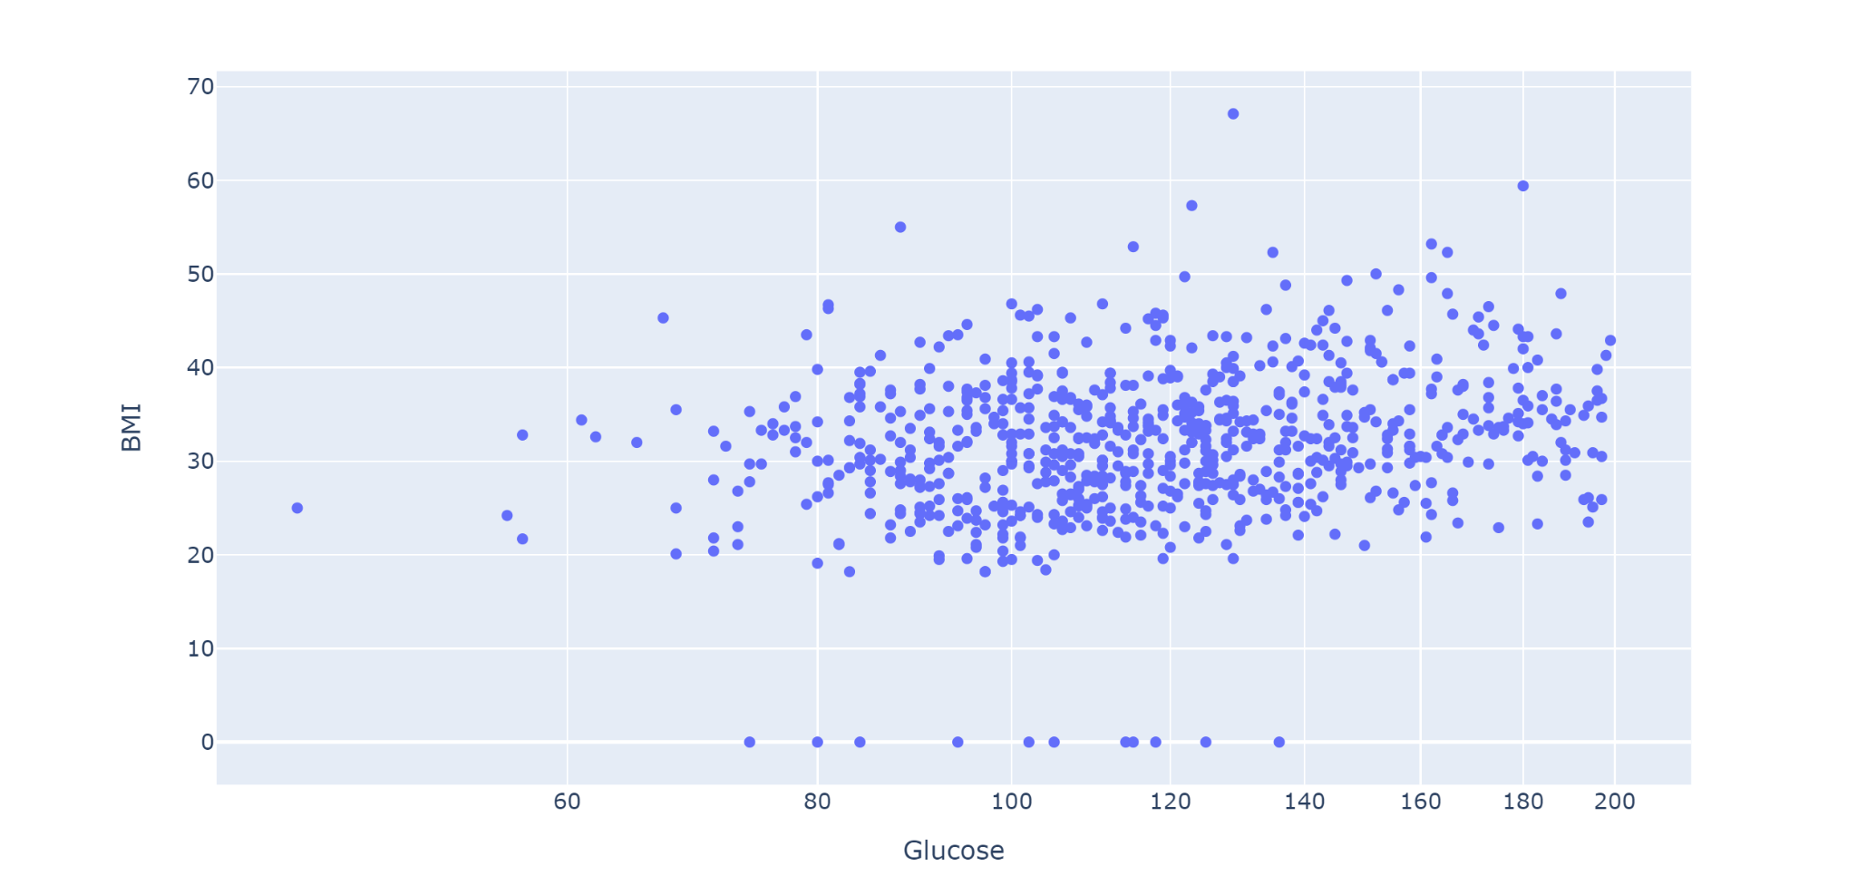
Scatter Visualization
This graph shows a positive correlation, but just like insulin it is not strong.
Both glucose and insulin have a positive correlation with BMI

Slide 9
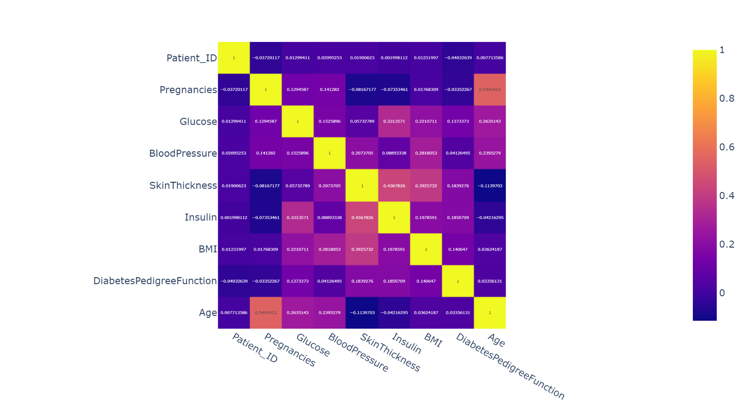
Heatmap Visualization
After finding out insulin and glucose have a positive correlation with BMI I decided to do a heat map which serves as a correlation matrix
Most of these conditions have a correlation level of less of 0.5 which tells me they all affect BMI differently and are not strongly correlated with each other and can be used as accurate predictors

Slide 10
Findings/Insights
I did linear regression and I got 77% accuracy
The predictors I used was glucose, blood pressure, skinthickness, insulin, BMI, and DiabetesPedigreeFunction
I applied the tree model and used metrics.accuracy_score method and got a score of 100%

Slide 11
Recommendations/Future work
diet can have an effect on blood sugar levels, eating too many carbs will raise blood sugar levels
Exercise according to the cdc can also help control blood sugar levels it helps maintain the body’s metabolism by burning down food much faster during exercise
Diet can help make your machine learning more accurate because you could see how someone levels responds when given a diet

